Slide 1
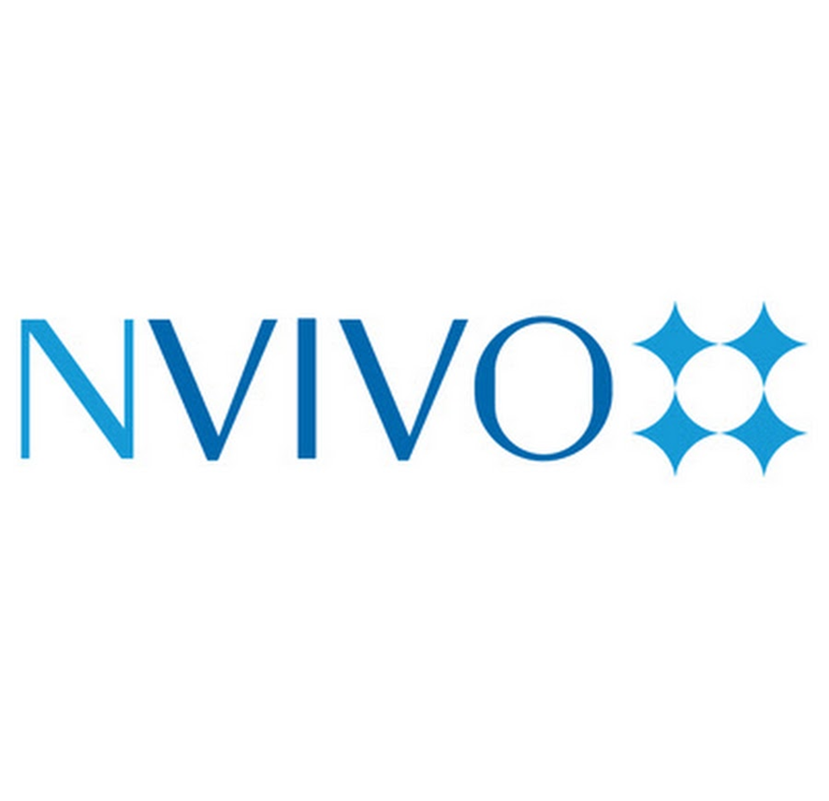
Hyfforddiant NVivo
Cyflwyniad i'r feddalwedd
Emma Grigorian

Slide 2
Hyfforddiant NVivo: Sesiwn 1
Beth yw NVivo?
Ar gyfer beth mae ymchwilwyr yn defnyddio NVivo.
Sut i lawrlwytho NVivo, mewngofnodi a sut mae'r drwyddedu'n gweithio.

Slide 3
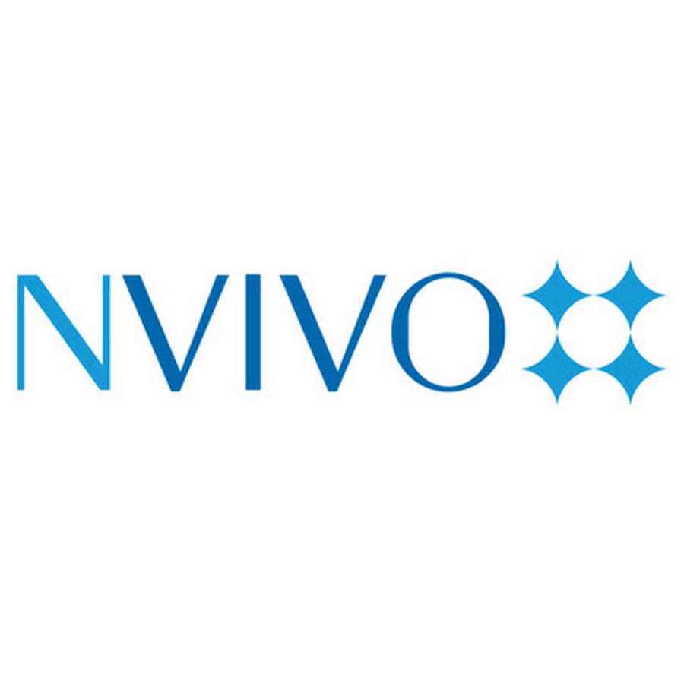
Beth yw Nvivo?
Mae NVivo yn feddalwedd cyfrifiadurol ar gyfer dadansoddi data ansoddol neu ddulliau cymysg, sy’n helpu ymchwilwyr i drefnu, archwilio a dehongli data nad yw’n feintiol.

Slide 4
Pryd defnyddir NVivo?
Trawsgrifiadau cyfweliadau a grwpiau ffocws,
Nodiadau gwaith maes,
Ymatebion agored mewn holiaduron,
Delweddau, fideos a chyfryngau cymdeithasol,
Erthyglau a phapurau newyddion.

Slide 5
Beth mae NVivo yn ei wneud?
Mae NVivo yn darparu lle gwaith strwythuredig lle gall ymchwilwyr:
godio testunau a chyfryngau yn ôl themâu;
creu cysylltiadau rhwng syniadau, pobl a chategorïau;
storio metadata (e.e. gwybodaeth am gyfranogwyr);
rhedeg ymholiadau i ganfod patrymau a chymariaethau;
creu delweddaethau fel mapiau thematig, siartiau a modelau.
Mae gwasanaeth trawsgrifio sydd ar gael ar lein ond nid yn Gymraeg.
Mae gan y fersiwn premium nodweddion AI.

Slide 6

Beth mae Nvivo yn ei wneud?
Yn draddodiadol, dadansoddir data ansoddol gan ddefnyddio pennau uwcholeuo a nodiadau.
Mae NVivo darparu amgylchedd i storio data testunol i’w wneud yn haws i godio data a chreu nodiadau, gan gadw’r data o fewn yr un lle.
Mae gan NVivo offerynnau eraill i’ch helpu gyda’r dadansoddiad.

Slide 7
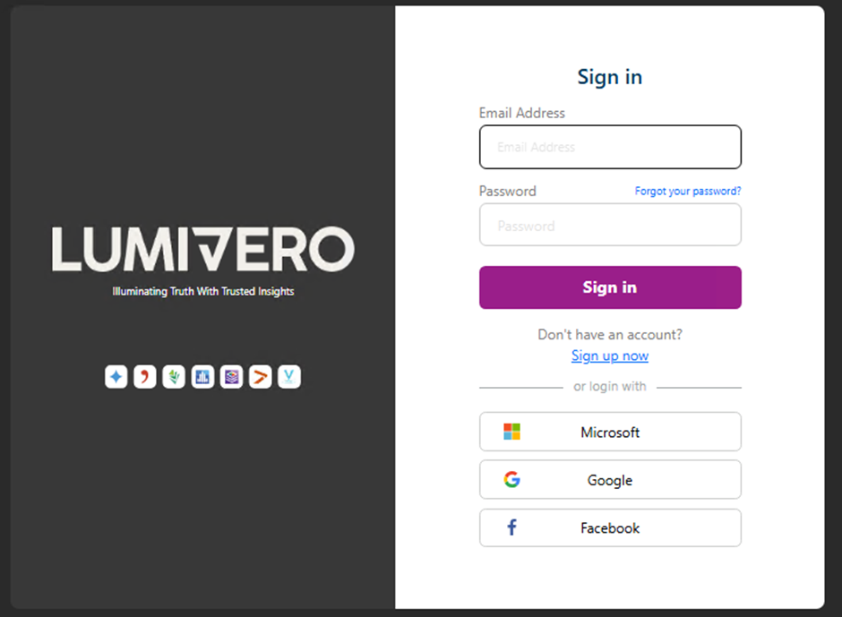
Sut i lawrlwytho NVivo?
Yn eich porwr gwe, ewch i
https://my.lumivero.com/
Cliciwch ar yr opsiwn ‘Sign up now’ os nad oes gennych chi gyfrif yn barod. Rydych chi’n gallu defnyddio eich e-bost prifysgol neu bersonol ar gyfer hyn.

Slide 8
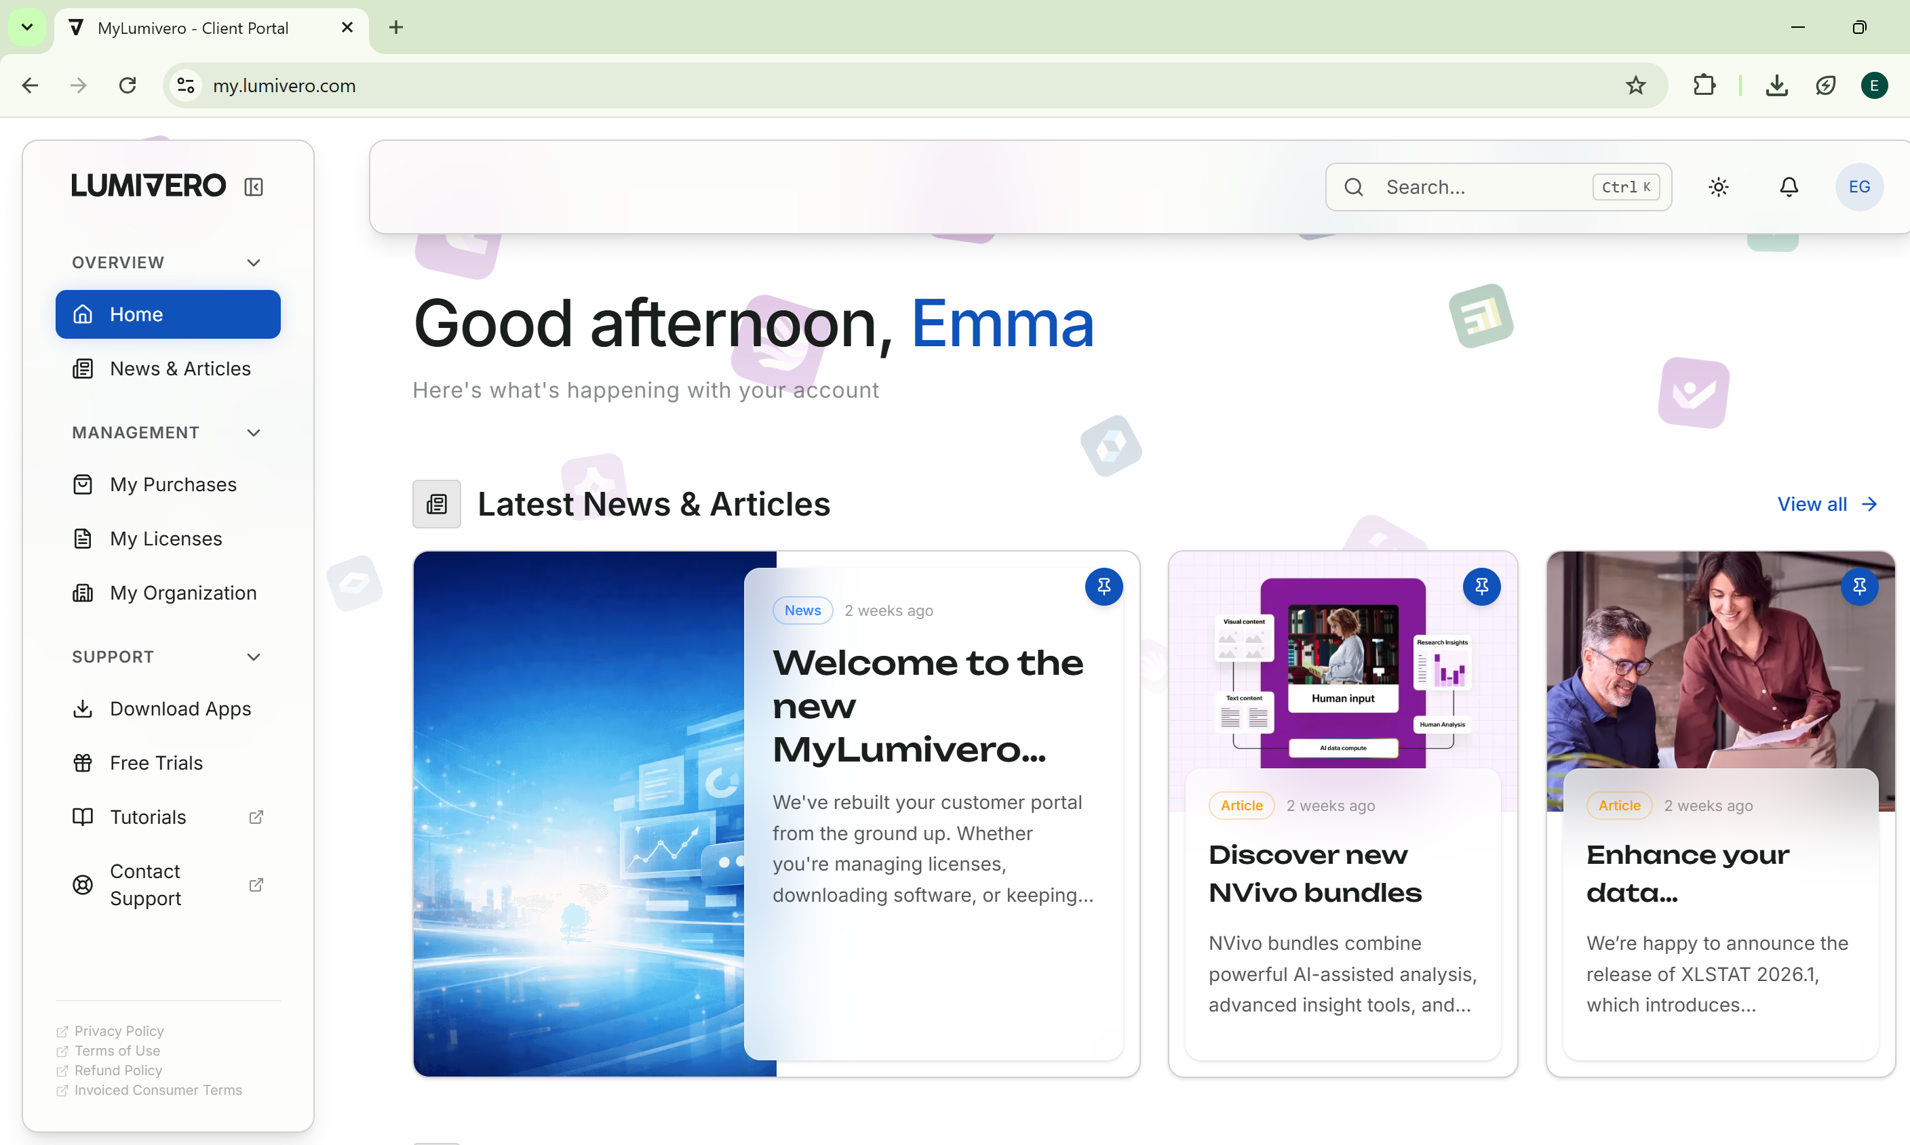
Sut i lawrlwytho NVivo?
Unwaith eich bod chi wedi creu’r cyfrif, mewngofnodwch a cliciwch ar ’Download Apps’.

Slide 9
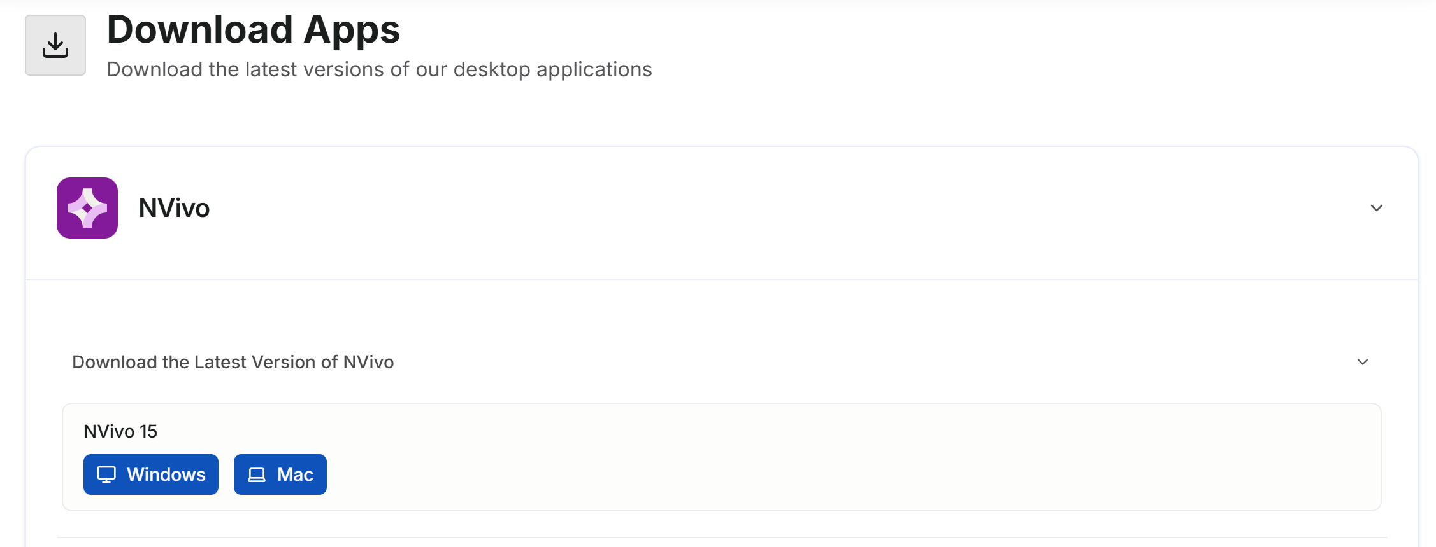
Sut i lawrlwytho NVivo
Dewiswch y fersiwn sydd ei hangen o Nvivo.
Notes:
Yn y sesiynau hyfforddiant hyn, rydym yn lawrlwytho'r fersiwn ddiweddaraf o Nvivo ar gyfer Windows.
Y fersiwn ddiweddaraf yw Fersiwn 15 ar hyn o bryd ond gallwch ddod o hyd i fersiynau 13 a 14 a fersiynau ar gyfer MacOS o dan ‘Fersiynau Eraill’.

Slide 10
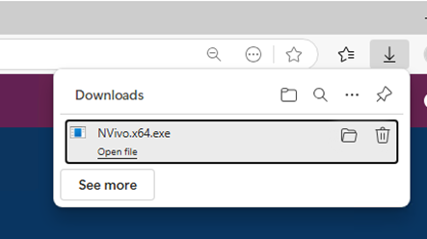
Sut i lawrlwytho NVivo
Ar ôl iddo orffen lawrlwytho, cliciwch ar y lawrlwythiad i ddechrau gosod y feddalwedd.

Slide 11
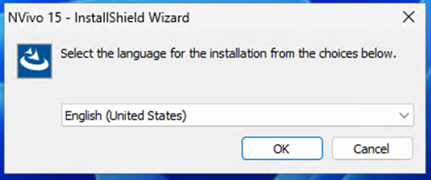
Sut i lawrlwytho NVivo
Dewiswch yr iaith rydych chi’n defnyddio i ddefnyddio’r feddalwedd.
Yn anffoddus, nid yw’r Gymraeg ar gael.

Slide 12
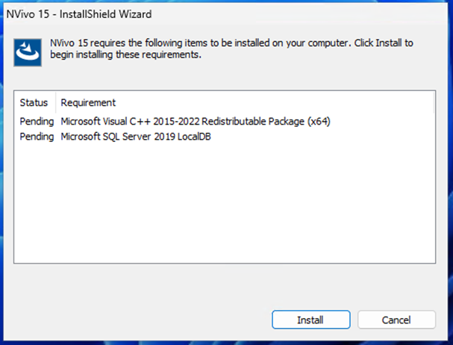
Sut i lawrlwytho NVivo
Cliciwch ar ‘Install’ a bydd y rhaglen yn dechrau cael ei gosod ar eich cyfrifiadur.

Slide 13
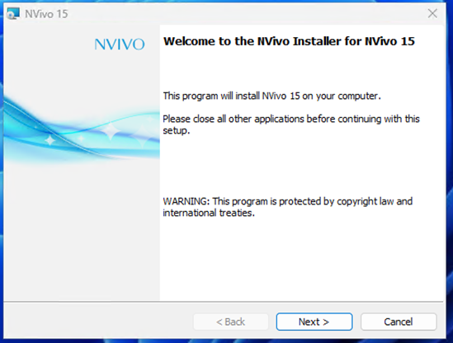
Sut i lawrlwytho NVivo
Unwaith mae’r brif osodwr wedi cychwyn, cliciwch ar ‘Next’.

Slide 14
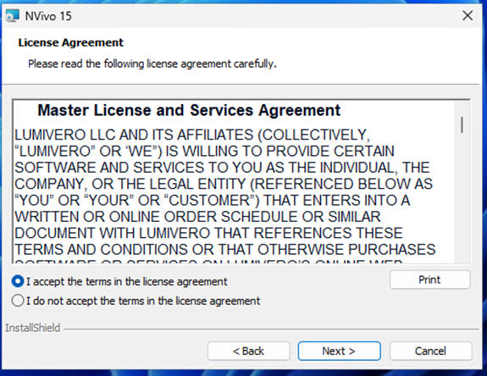
Sut i lawrlwytho NVivo
Cliciwch i dderbyn y cytundeb trwydded ac wedyn ‘next’ eto.

Slide 15
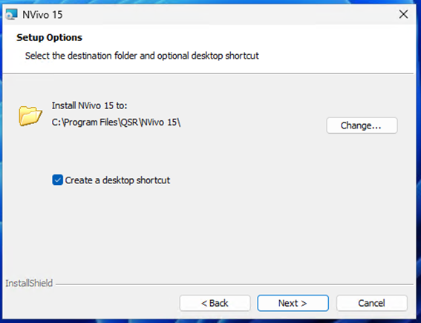
Sut i lawrlwytho NVivo
Dewiswch os ydych chi eisiau creu llwybr byr ar eich bwrdd gwaith.
Gwnewch yn siŵr bod y feddwlwedd yn lawyrlwytho mewn lle sy’n gwneud synnwyr.
Cliciwch ar ‘Next’ eto.

Slide 16
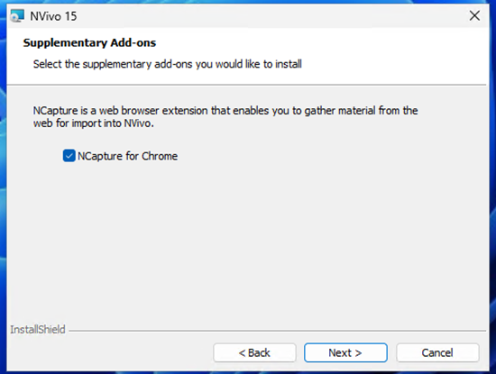
Sut i lawrlwytho NVivo
*Rhan dewisol!
Os ydych chi’n defnyddio Google Chrome, mae opsiwn i chi gosod NCapture.
Notes:
Os ydych chi’n defnyddio Google Chrome, mae opsiwn I chi gosod NCapture.
Captures web pages
Saves the full page (or a simplified version) so you can code it in NVivo.
• Captures social media content
Works with platforms like X/Twitter and Facebook (within the limits those platforms allow).
It gathers posts, comments, metadata, timestamps, etc.
• Captures PDFs from the web
If a page is actually a PDF, NCapture can pull it directly into NVivo.
• Packages everything into a .nvcx file
This file imports neatly into NVivo as a source you can code, query, and link.
What it doesn’t do
• It doesn’t scrape everything from every site — some platforms block automated capture.
• It doesn’t analyse anything itself; it just gathers the data for NVivo to work with.
Why researchers use it
• Saves time copying/pasting online data
• Preserves structure and metadata
• Makes social‑media and web‑based research far more manageable

Slide 17
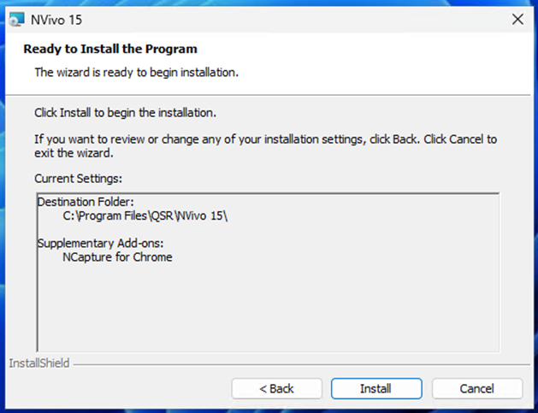
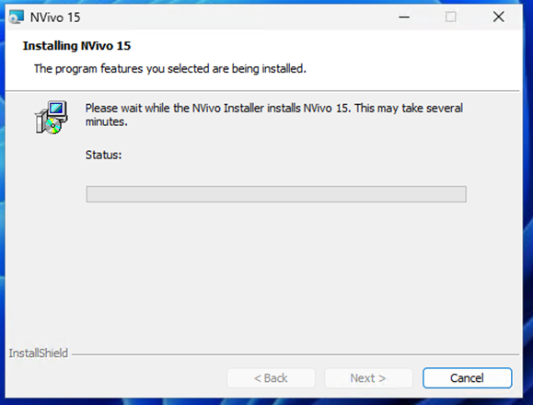
Sut i lawrlwytho NVivo
Cliwich ar ‘Install’ i barhau i osod y feddalwedd.
Notes:
Os ydych chi’n defnyddio Google Chrome, mae opsiwn I chi gosod NCapture.
Captures web pages
Saves the full page (or a simplified version) so you can code it in NVivo.
• Captures social media content
Works with platforms like X/Twitter and Facebook (within the limits those platforms allow).
It gathers posts, comments, metadata, timestamps, etc.
• Captures PDFs from the web
If a page is actually a PDF, NCapture can pull it directly into NVivo.
• Packages everything into a .nvcx file
This file imports neatly into NVivo as a source you can code, query, and link.
What it doesn’t do
• It doesn’t scrape everything from every site — some platforms block automated capture.
• It doesn’t analyse anything itself; it just gathers the data for NVivo to work with.
Why researchers use it
• Saves time copying/pasting online data
• Preserves structure and metadata
• Makes social‑media and web‑based research far more manageable

Slide 18
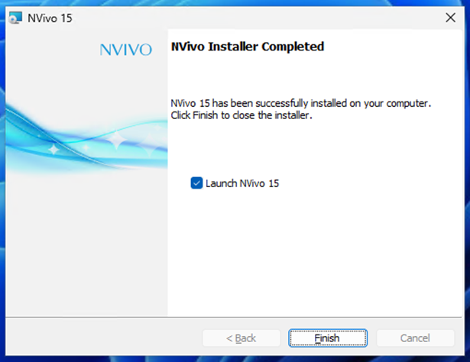
Sut i lawrlwytho NVivo
Os ydych chi’n gweld hyn, rydych chi wedi gosod NVivo yn llwyddiannus.
Os oes unrhyw broblemau cysylltwch â’ch adran cefnogaeth cyfrifiadurol neu cyswllt cefnogaeth ar wefan Lumivero.
Notes:
Os ydych chi’n defnyddio Google Chrome, mae opsiwn I chi gosod NCapture.
Captures web pages
Saves the full page (or a simplified version) so you can code it in NVivo.
• Captures social media content
Works with platforms like X/Twitter and Facebook (within the limits those platforms allow).
It gathers posts, comments, metadata, timestamps, etc.
• Captures PDFs from the web
If a page is actually a PDF, NCapture can pull it directly into NVivo.
• Packages everything into a .nvcx file
This file imports neatly into NVivo as a source you can code, query, and link.
What it doesn’t do
• It doesn’t scrape everything from every site — some platforms block automated capture.
• It doesn’t analyse anything itself; it just gathers the data for NVivo to work with.
Why researchers use it
• Saves time copying/pasting online data
• Preserves structure and metadata
• Makes social‑media and web‑based research far more manageable

Slide 19
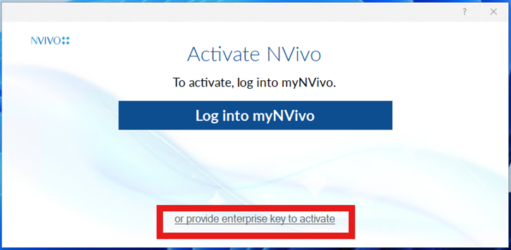
Sut i lansio NVivo
Notes:
Os ydych chi’n defnyddio Google Chrome, mae opsiwn I chi gosod NCapture.
Captures web pages
Saves the full page (or a simplified version) so you can code it in NVivo.
• Captures social media content
Works with platforms like X/Twitter and Facebook (within the limits those platforms allow).
It gathers posts, comments, metadata, timestamps, etc.
• Captures PDFs from the web
If a page is actually a PDF, NCapture can pull it directly into NVivo.
• Packages everything into a .nvcx file
This file imports neatly into NVivo as a source you can code, query, and link.
What it doesn’t do
• It doesn’t scrape everything from every site — some platforms block automated capture.
• It doesn’t analyse anything itself; it just gathers the data for NVivo to work with.
Why researchers use it
• Saves time copying/pasting online data
• Preserves structure and metadata
• Makes social‑media and web‑based research far more manageable

Slide 20
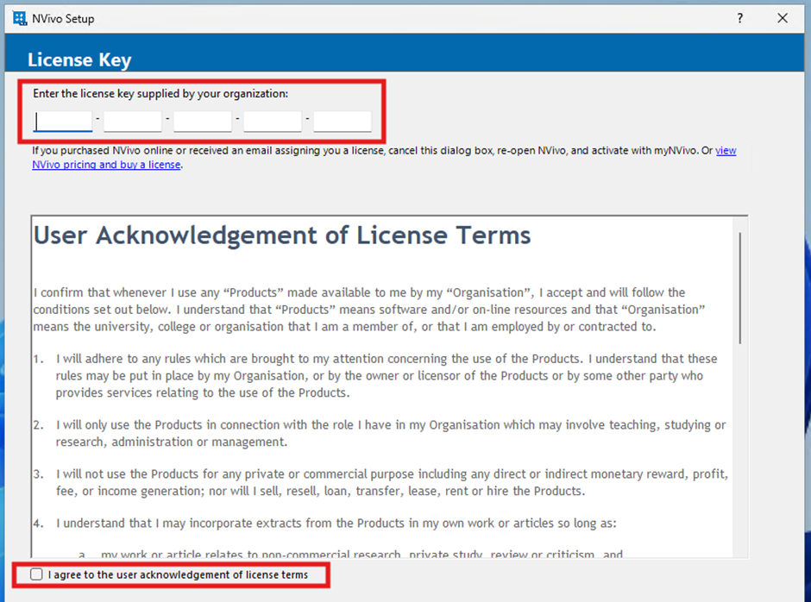
Sut i lansio NVivo
Notes:
Os ydych chi’n defnyddio Google Chrome, mae opsiwn I chi gosod NCapture.
Captures web pages
Saves the full page (or a simplified version) so you can code it in NVivo.
• Captures social media content
Works with platforms like X/Twitter and Facebook (within the limits those platforms allow).
It gathers posts, comments, metadata, timestamps, etc.
• Captures PDFs from the web
If a page is actually a PDF, NCapture can pull it directly into NVivo.
• Packages everything into a .nvcx file
This file imports neatly into NVivo as a source you can code, query, and link.
What it doesn’t do
• It doesn’t scrape everything from every site — some platforms block automated capture.
• It doesn’t analyse anything itself; it just gathers the data for NVivo to work with.
Why researchers use it
• Saves time copying/pasting online data
• Preserves structure and metadata
• Makes social‑media and web‑based research far more manageable

Slide 21
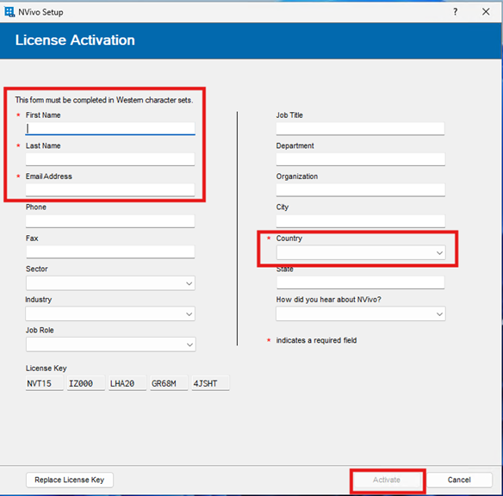
Sut i lansio NVivo
Llenwch y blychau angenrheidiol i weithredu eich trwydded.
Notes:
Os ydych chi’n defnyddio Google Chrome, mae opsiwn I chi gosod NCapture.
Captures web pages
Saves the full page (or a simplified version) so you can code it in NVivo.
• Captures social media content
Works with platforms like X/Twitter and Facebook (within the limits those platforms allow).
It gathers posts, comments, metadata, timestamps, etc.
• Captures PDFs from the web
If a page is actually a PDF, NCapture can pull it directly into NVivo.
• Packages everything into a .nvcx file
This file imports neatly into NVivo as a source you can code, query, and link.
What it doesn’t do
• It doesn’t scrape everything from every site — some platforms block automated capture.
• It doesn’t analyse anything itself; it just gathers the data for NVivo to work with.
Why researchers use it
• Saves time copying/pasting online data
• Preserves structure and metadata
• Makes social‑media and web‑based research far more manageable

Slide 22
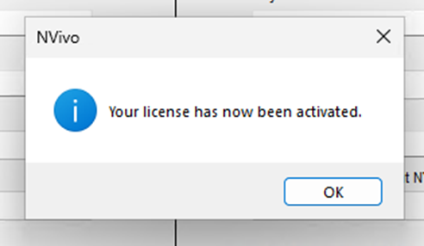
Sut i lansio NVivo
Notes:
Os ydych chi’n defnyddio Google Chrome, mae opsiwn I chi gosod NCapture.
Captures web pages
Saves the full page (or a simplified version) so you can code it in NVivo.
• Captures social media content
Works with platforms like X/Twitter and Facebook (within the limits those platforms allow).
It gathers posts, comments, metadata, timestamps, etc.
• Captures PDFs from the web
If a page is actually a PDF, NCapture can pull it directly into NVivo.
• Packages everything into a .nvcx file
This file imports neatly into NVivo as a source you can code, query, and link.
What it doesn’t do
• It doesn’t scrape everything from every site — some platforms block automated capture.
• It doesn’t analyse anything itself; it just gathers the data for NVivo to work with.
Why researchers use it
• Saves time copying/pasting online data
• Preserves structure and metadata
• Makes social‑media and web‑based research far more manageable

Slide 23
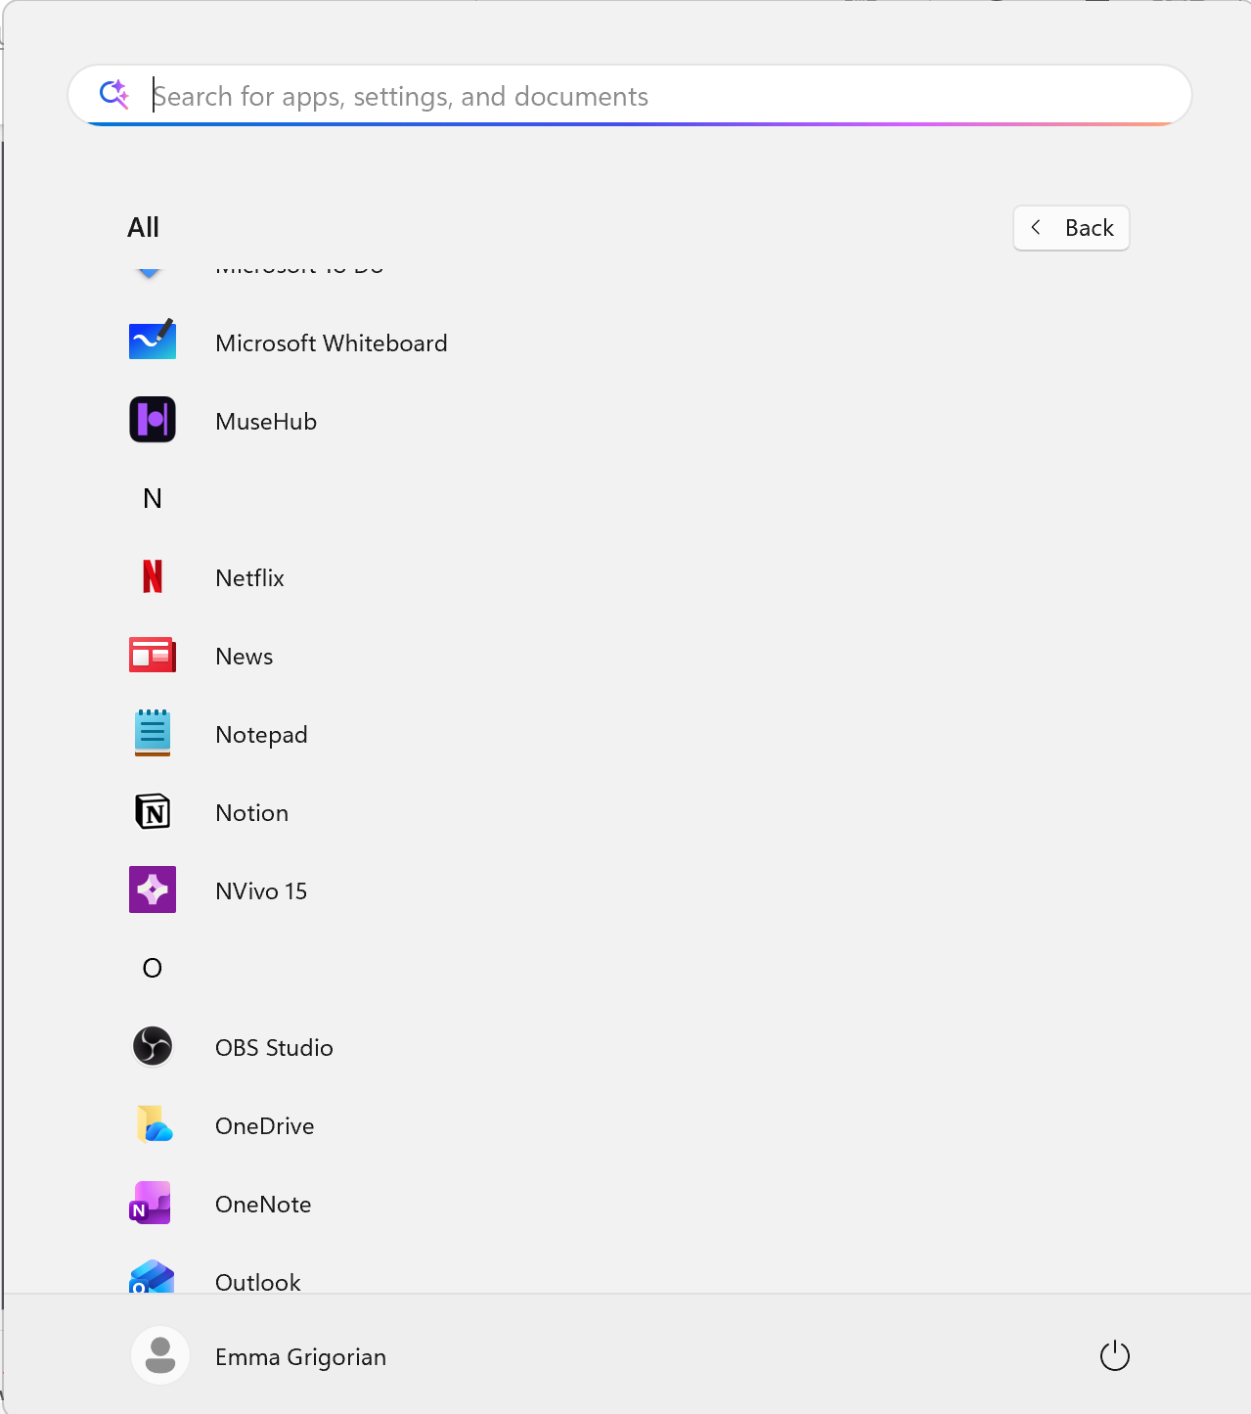

Sut i lansio NVivo
Notes:
Os ydych chi’n defnyddio Google Chrome, mae opsiwn I chi gosod NCapture.
Captures web pages
Saves the full page (or a simplified version) so you can code it in NVivo.
• Captures social media content
Works with platforms like X/Twitter and Facebook (within the limits those platforms allow).
It gathers posts, comments, metadata, timestamps, etc.
• Captures PDFs from the web
If a page is actually a PDF, NCapture can pull it directly into NVivo.
• Packages everything into a .nvcx file
This file imports neatly into NVivo as a source you can code, query, and link.
What it doesn’t do
• It doesn’t scrape everything from every site — some platforms block automated capture.
• It doesn’t analyse anything itself; it just gathers the data for NVivo to work with.
Why researchers use it
• Saves time copying/pasting online data
• Preserves structure and metadata
• Makes social‑media and web‑based research far more manageable

Slide 24
Unrhyw broblemau?
Cysylltwch ag:
Eich adran cefnogaeth cyfrifiadurol
Cyswllt cefnogaeth ar wefan Lumivero

